Slide 1

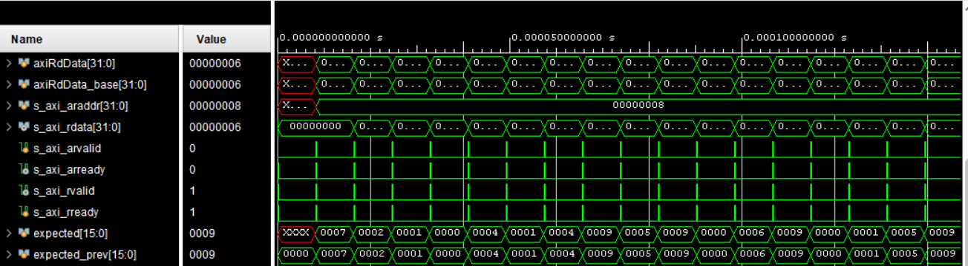
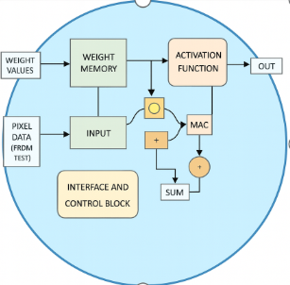
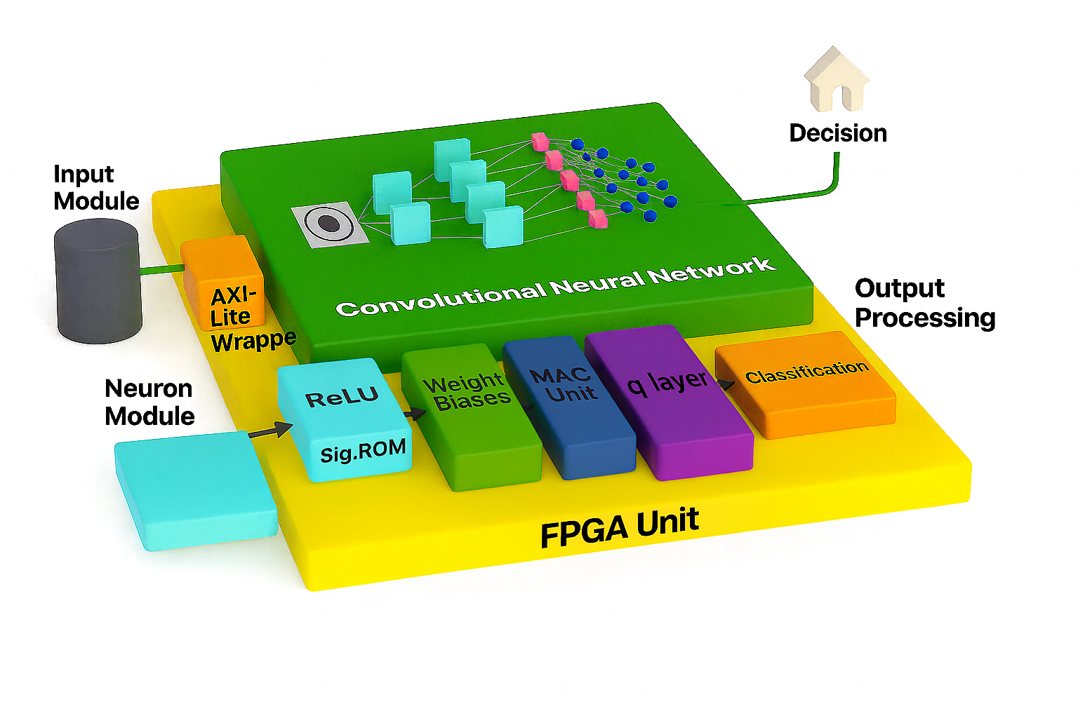
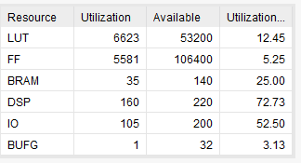
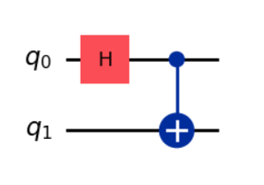
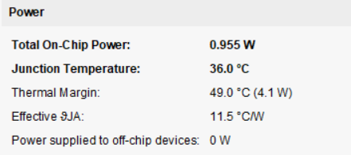
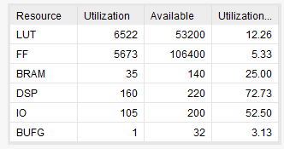
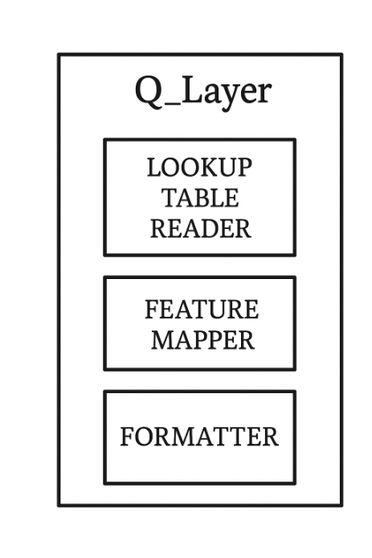
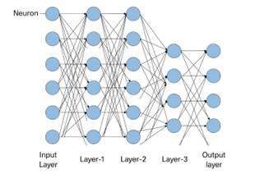
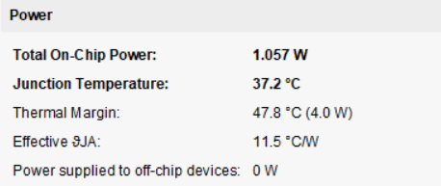
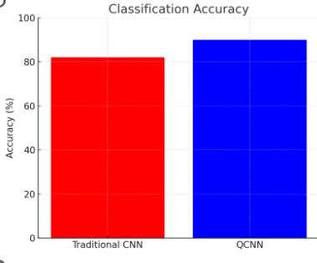
Electrical Engineering Department
Q-CNN for 2D Image Classification on FPGA
Project Advisor: Prof. Shrikant Jadhav
Vishnu Deep PandurangaRao (MS Electrical Engineering)
Isha Jadhav (MS Electrical Engineering)
Introduction
Methodology
The outputs form the Q layer is fed to the Max pooling layer by reverting them back to fixed-point integers using scaling factors and makes sure the values are suitable for hardware operations.
This project is an implementation of the Quantum Convolutional Neural Network (Q-CNN) on an FPGA. The aim of this project is to implement the QCNN and traditional CNN and compare both the designs in terms of performance, resource utilization and power consumption.
The function of these CNN’s is to identify the handwritten digits from the MNIST data set.
This goes on to prove that even though the utilization of the QCNN is slightly high , the efficiency is increased .
The RTL designs and the testbenches are written in Verilog HDL/System Verilog and is realized using Xilinx Vivado.
The other components of the neuron is weight memory which contains weight values , the activation function which is ReLU and sigmoid function , the interface and control block the MAC unit (multiply and accumulate).
In case of the Q-CNN there is an additional layer which does the Hadamard operations on the output obtained by all other layers and feeds it to the max finder layer which finds out which connection has the highest activity and concludes a particular value.
Analysis and Results
Traditional CNN Results :
The Traditional CNN used to identify the Handwritten digits from the MNIST data set provides an accuracy of 82% when tested .
The testing of both the CNNs are done by a System Verilog testbench which passes the pixel data i.e. 28x28 image which gives 784-pixel values to the first layer.
The testbench helps in carrying out behavioral simulation there by enabling in verifying the behavior of the RTL of the CNN by comparing the actual output obtained from the Max Finder layer and the expected output.
Fig11. Q-CNN Behavioural Simulation Results
Summary/Conclusions
The project successfully implements the traditional and Quantum CNN and their accuracy in identifying 2D images, in this case hand written digits. By integrating the Quantum behavior of a Hadamard gate from the IBM Qi skit library on the FPGA compatible design and implementing it on the Vivado IDE to realize the implemented design and get its performance parameters & resource utilization along with testing it behaviorally using a testbench to obtain the accuracy of each CNN.
Fig1. Q-CNN on the FPGA
The type of Quantum gate chosen is Hadamard gate , which can represent data from (-1) to (1).
[1] A. Mitra, S. Ghosh and S. Mandal, "Optimum Resource Utilization for the Implementation of FPGA-based Fast Convolutional Algorithms for CNN Modelling," 2020 IEEE Calcutta Conference (CALCON), Kolkata, India, 2020, pp. 84–88, doi: 10.1109/CALCON49167.2020.9106477.
[2] S. Sathiyamoorthi and R. Gnanamurthy, "Implementation of Data-optimized FPGA-based Accelerator for Convolutional Neural Network," 2020 Fourth International Conference on Computing Methodologies and Communication (ICCMC), Erode, India, 2020, pp. 1–6, doi: 10.1109/ICCMC48092.2020.ICCMC-00030.
[3] N. H. Bach, L. H. Vu, D. L. Tran, T. T. Dao, T. T. H. Luu, and D. N. Nguyen, "Re-structuring CNN Using Quantum Layer Executed on FPGA Hardware for Classifying 2-D Data," in Proc. 9th Int. Conf. Integrated Circuits, Design, and Verification (ICDV), Hanoi, Vietnam, Feb. 2024, pp. 143–150.
[4] J. Pilch and J. Długopolski, "An FPGA-Based Real Quantum Computer Emulator," J. Comput. Electron., vol. 18, no. 2, pp. 329–342, Dec. 2018.
Fig6. CNN Resource utilization
Key References
Fig4. Neuron and its components
The way the Hadamard characteristics are implemented on the FPGA design is by creating a Lookup table approach to hold the values and map their results to the Hadamard Transform equivalent and pass them on to the max finder where the digit is identified.
The quantum gate behavior is simulated on Google Collab by using the IBM Qi skit library , the lookup table module was created by using the SUM values of the layer 4 which were passed on to Max finder in the traditional CNN.
Inside the Quantum layer of the CNN , there is lookup table values , data formatting of the same , it is read in pre-computed probability values .
Fig2. Hadamard Gate
Quantum CNN Results:
The Quantum CNN with a Quantum layer before the output layer has slightly more flip flops implemented on the FPGA due the addition of Q-layer and the Lookup table logic ,formatting logic etc. The power consumed will be slightly high.
The QCNN offers an accuracy of 90 % .
Fig7. CNN power report
Methodology
The CNN used is a pre-trained one , where the weights and biases are not changed dynamically, there is a weight memory module that stores all possible weight values and bias values in (.mif) files and used for computation.
The CNN in both the cases is comprised of 5 layers the first layer being the input layer which takes in the pixel data , the second layer consist of 30 Neurons, the third layer also consists of 30 Neurons , the remaining the layers contain 10 Neurons each, here Neuron is the basic building block of the CNN.
Fig8. QCNN Resource utilization
Acknowledgements
We would like to thank San Jose State University and the Professors of Electrical Engineering Department for providing an opportunity to enhance and learn more on the RTL design, Verification and FPGA implementation. Our sincere thanks to Prof.Shrikant Jadhav for his expert guidance, support & motivation throughout this project.
Fig9. QCNN power report
Fig3. CNN layers with Neurons
Fig5. Q-layer breakdown
Fig10. CNN vs QCNN Accuracy

